Slide 1
MTP- Mid Sem

Slide 2
Table of Contents-
1- Introduction
2- Problem Statement
3- Model Compression Techniques
4- Knowledge Distillation A- Response Based Distillation B- Feature Based Distillation C- Relation Based Distillation 5- Challenges and Future Scope

Slide 3
Introduction-
Deep neural networks have been successful in many areas, but deploying them to end-user applications remains challenging.
Edge devices, such as mobile phones, wearables, IoT, embedded and autonomous systems, and intelligent sensors, have limited memory, computing resources, and power handling capability.
To reduce cloud transmission cost, optimization techniques have been developed to handle DL deployment efficiently on the edge.
Deep learning or Deep neural network is one of the subfields of ML. The three main layers of an NN are the input layer, hidden layers, and output layer.

Slide 4
The deployment of DL models for inference can be of two main types:
1- Cloud-based processing 2- Inference on edge
Edge inference has many advantages over cloud-based computing, such as faster and real-time use cases, better security, bandwidth efficiency, scalability, and reliability.
Edge computing is a new way of doing computing where processing happens closer to where the data is created, making it easier to use DL in real life situations.
There are surveys available on topics related to DL, such as theories, designs, algorithms, and uses.
Discussions on compression performance evaluation are limited, software frameworks are absent, and there is a lack of reviewing hardware acceleration platforms.

Slide 5
Problem Statement-
There are many types of edge devices are available with limited memory and computing capability and many kinds of model compression techniques are also present but analysis among them is very less.
We can not perform evaluations on actual hardware everytime, we need a simulator where we can simulate actual hardware and try different compression techniques and analyse their performance but we don’t have a free open source platform where we can perform these analysis.
There are very less studies available about how different compression techniques works with different kind of hardware.
First of all, I am focusing on a kind of Model Compression technique called as Knowledge Distillation/ Feature Distillation and will try it on different Edge devices and evaluate performance.

Slide 6
DEEP LEARNING MODEL COMPRESSION FOR EDGE INFERENCE-
A. Pruning- Pruning is a compression technique that removes less important weights (connections) or filters (channels) from a trained model.
B. Quantization- Quantization is a technique used in deep learning models to map model parameters and activations into low-precision quantized levels, which reduces memory usage and improves inference time. Quantization provides benefits like memory saving, reduced complexity, and improved energy efficiency.
C. Joint Compression and Weight Sharing- Joint compression and weight sharing techniques are applied together with pruning and quantization to reduce the storage requirements of deep learning models. Weight sharing reduces the number of unique weights by using k-means clustering and Huffman coding,

Slide 7
D. Multiply and Accumulate Optimization- One of the main computational complexities of DL algorithms comes from multiplication operations. Therefore, optimization of the multiplication by replacing it or removing part of the multiplication can significantly improve the inference performance. Shift Operations or storing multiplication values.
E. Knowledge Distillation- KD is a compression method that mimics the behavior of a large DL model into a lightweight model by transferring learned knowledge.
F. Adaptive Optimization Techniques- Adaptive optimization techniques allow tuning during inference runtime based on the current input to the network. Like for NLP, recognizing a simple sentence is much easier than a complex sentence Or object detection from a blurry image is more difficult than detection from a clear picture.

Slide 8
Knowledge Distillation-
Knowledge Distillation which is the process of converting complex model behaviour to smaller one in terms of a number of parameters while maintaining validity.
In machine learning, knowledge distillation refers to the process of transferring knowledge from a large model to a smaller one. While huge models have larger knowledge capacity than small models, this capacity may not be utilized to its full potential.
Smaller models can be put on less powerful hardware because they are less expensive to evaluate.
Knowledge distillation involves a small “student” model learning to mimic a large “teacher” model and using the teacher’s knowledge to achieve similar or superior accuracy.

Slide 9
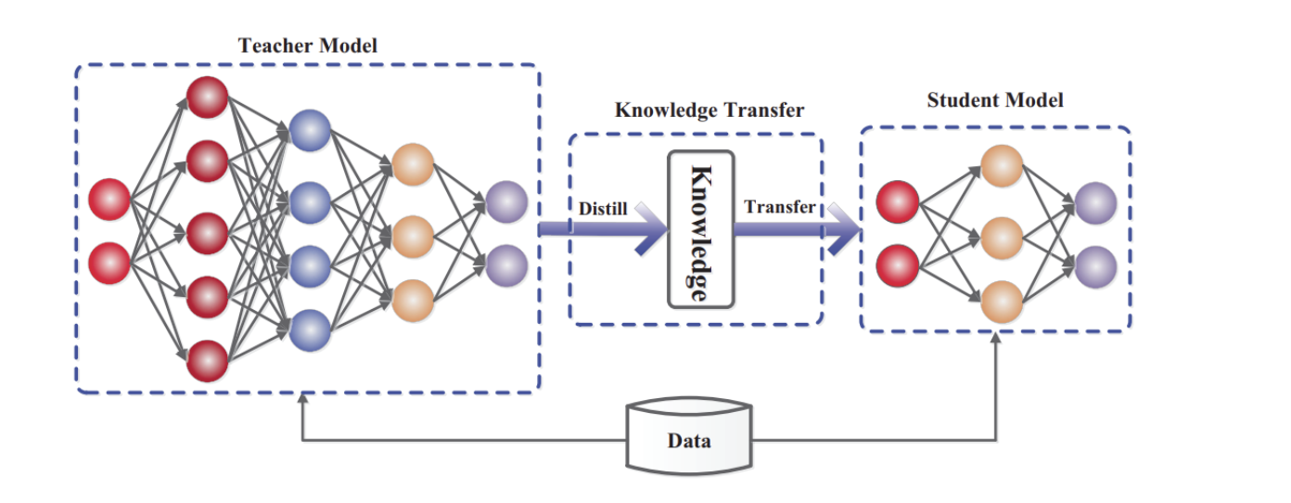

Slide 10
Teacher Model- Big Trained Model
Student Model- A smaller model that will rely on the Teacher Network’s distilled knowledge. It employs a different type of training called “distillation” to transfer knowledge from the large model to the smaller Student model.
Types of knowledge distillation
1-Response based distillation
2- Feature Based Distillation
3- Relation based distillation

Slide 11
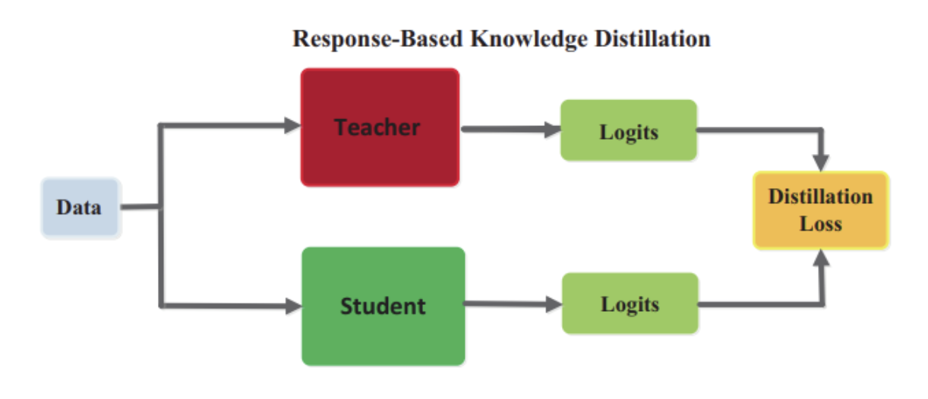
Response Based Distillation-
Response-based knowledge is the focus of the teacher model’s final output layer. The student model will learn to mimic the teacher model’s predictions, according to the hypothesis.
The student model will become more accurate in making predictions similar to the teacher as loss is reduced over time.

Slide 12
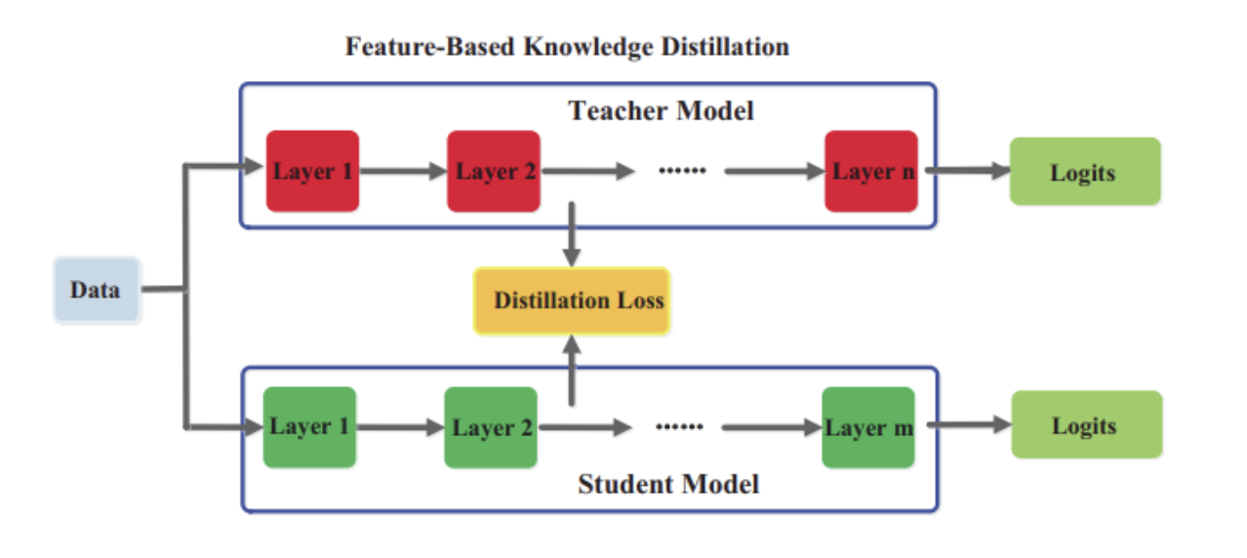
Feature Based Distillation-
A trained teacher model also captures data knowledge in its intermediate layers, which is particularly important for deep neural networks.
The intermediate layers learn to discriminate between specific features, which can then be used to train a student model.
Training the student model to learn the same feature activations as the teacher model. This is accomplished by minimizing the difference between the feature activations of the teacher and student models.

Slide 13
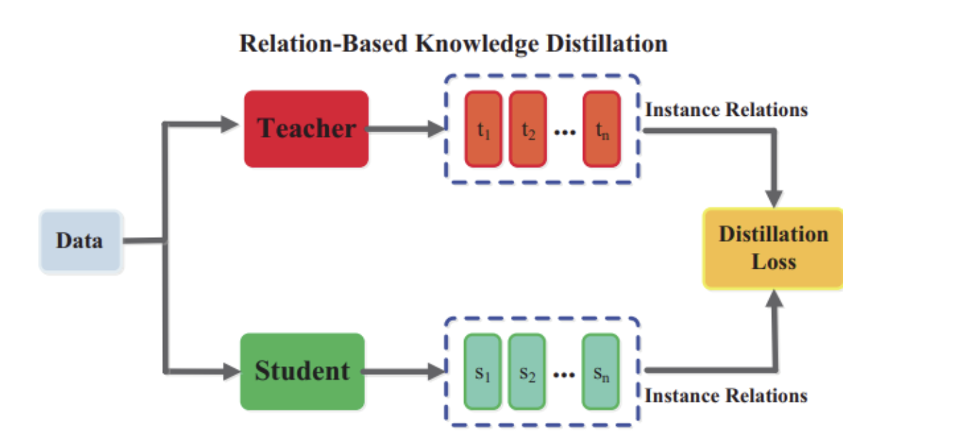
Relation Based Distillation-
Relationship based knowledge enlarges the connections between different layers or data samples.
A flow of solution process (FSP) defined by the Gram matrix between two layers was used to investigate the relationships between different feature maps.
The feature map pairs relationships are summarized in the FSP matrix. It is calculated by taking the inner products of the features of two layers.

Slide 14
CHALLENGES AND OPPORTUNITIES OF EDGE INFERENCE-
A. Adaptability to Data Heterogeneity: EI faces challenges due to data inconsistency caused by different sensors and environments. Research directions such as data augmentation and representation learning can mitigate this issue.
B. Automatic Mapping of DL to Hardware: Converting trained DL models to hardware-compatible versions is currently a manual and time-consuming process. Developing tools for automatic mapping of DL models on hardware is essential.
C. Edge-Aware Compression: Existing compression techniques often require manual intervention. Developing automatic compression techniques and exploring compression during training can improve efficiency.
D. Specialized hardware architectures are needed to accelerate compressed DNN models.
E. Focusing on Other DL Techniques: Existing techniques focus mostly on feedforward and convolutional neural networks. Research should expand to include other DL methods like sequence analysis for voice recognition, NLP etc.
F. Training on the Edge: Edge training with retraining capability and transfer learning can support continuous learning from new data. Challenges include layer level optimization, energy efficiency, mixed precision support, and dealing with unlabeled and sparse data.

